Slide 1

Python Project
Anas Aesa

Slide 2
Main problem
What do we try to predict?
We are trying to predict whether a customer will churn based on the customer features.
Main Problem
What data is available for that?
The available data for that is the Churn dataset, which include information about the customers.
Our motivation is to gain insights into the factors that contribute to customer churn and to develop targeted interventions to reduce this rate. our goal is to improve customer satisfaction and loyalty, while also maximizing revenue for the business.
What are the motivation?

Slide 3
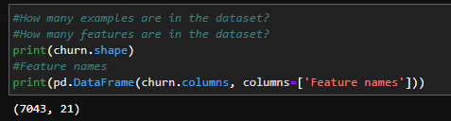

Data description
Features in the Dataset:
21
Examples in the Dataset:
7,043
Missing Values:
11
** There are 7, 043 examples in the Dataset; 21 features and 11 missing values.

Slide 4
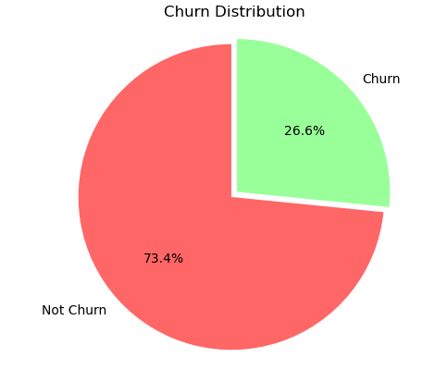
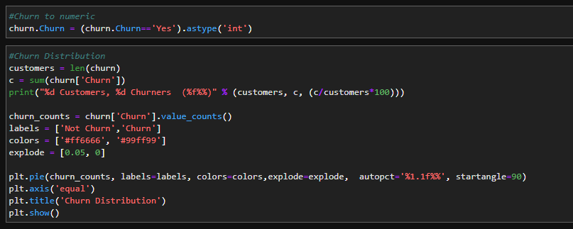
Data description
7032 Customers 1869 Churners (26.6%)

Slide 5
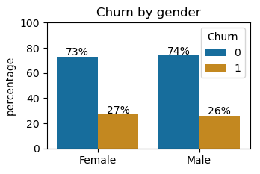
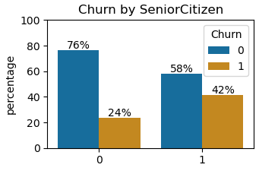
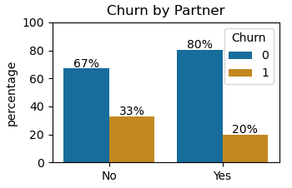
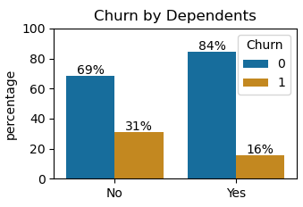
Data description
Churn Distribution by Demographic Features
It can be seen that the churn rate is not influenced by a gender of a customer, and it looks the same for males and females.
Senior citizens for some reason tend to churn more.
Customers without Partner are more likely to churn.
Customers without Dependents tend to churn more.

Slide 6
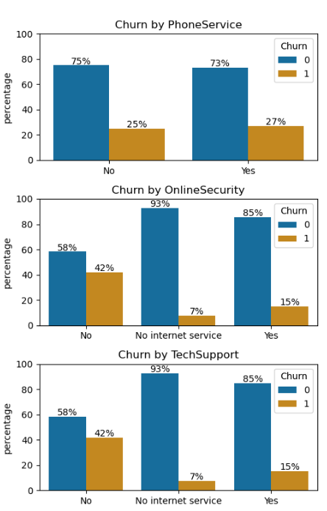
Data description
Churn Distribution by Services
It can be seen that Phone Service that a customer receives does not influence the chance that he will churn.
It is interesting to see that customers who don’t have Online Security service tend to churn more. Customers who don’t have an internet service at all – have the lowest churn rate (probably because they are not exposed to the competing companies).
The same rate is for the customers who don’t have the Tech Support Service.

Slide 7
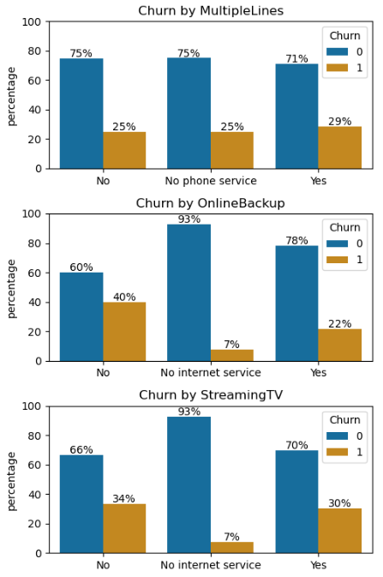
Data description
Churn Distribution by Services
We can see that Multiple Lines service almost does not influence the churn rate.
Customers who don’t have Online Backup tend to churn more than those who have it.
The churn rate is almost the same for those who have the Streaming TV service and for those who don’t.

Slide 8
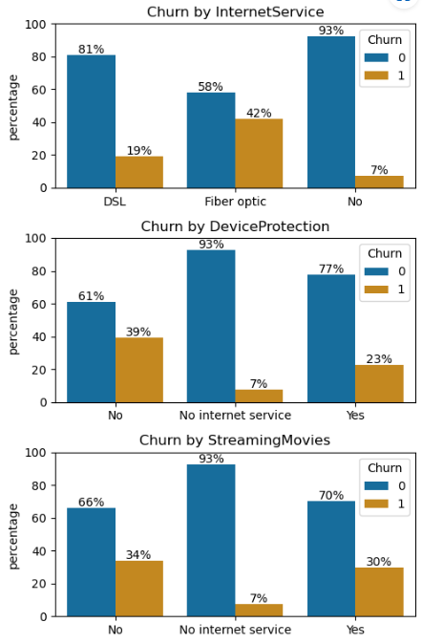
Data description
Churn Distribution by Services
Internet Service customers who have Fiber optic tend to churn more than users of the DSL or those who don’t have the service at all.
Customers who don’t have Device Protection churn more than those who have it.
Streaming Movies Services mostly does not influence the churn rate.

Slide 9
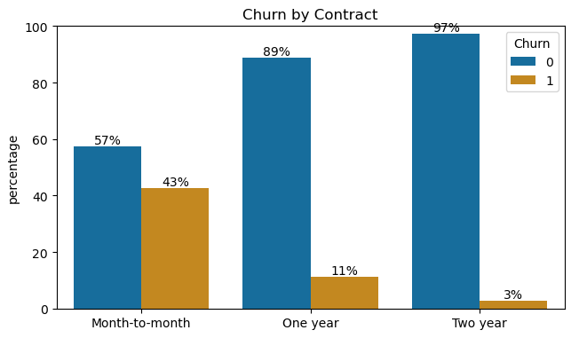
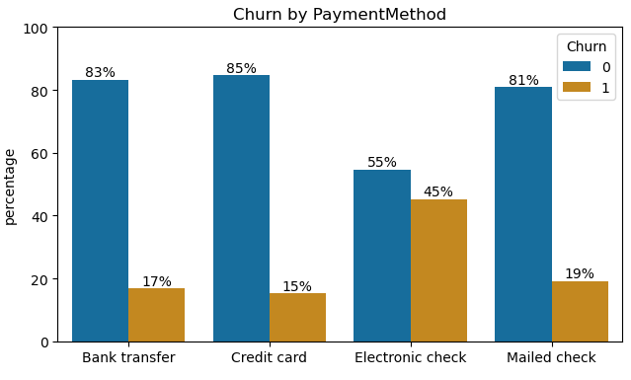
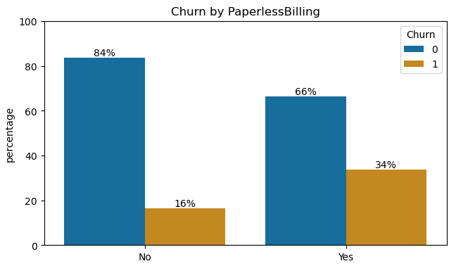
Data description
Churn Distribution by Customer Account Features
The churn rate is definitely higher among the customers who make Month-to-month payment. It should be created a marketing strategy that makes customer to move to Two-year payment contract.
Customers who pay with electronic check tend to churn more than other. Probably – they see parallelly on internet competitive companies as it easier to do at the time you pay.
Customers with Paperless Billing program churn more.

Slide 10
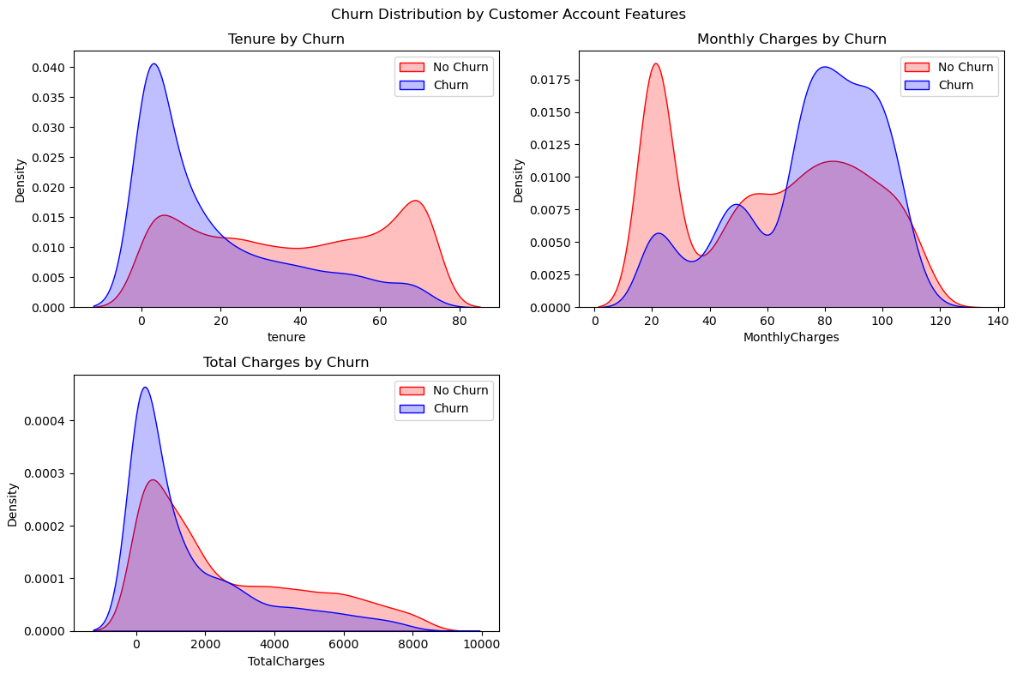
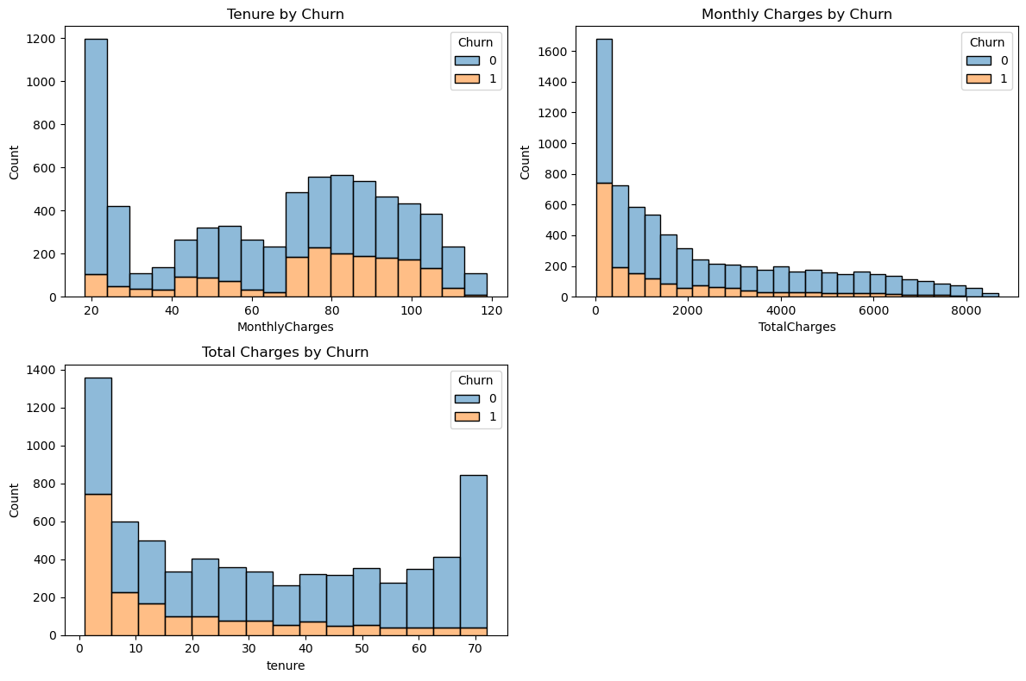
Data description
Churn Distribution by Customer Account Features
New customers tend to churn more.
Customers who have high monthly charges tend to churn more.
Customers with low total charges (probably are poorer but not for sure) have a higher churn rate.

Slide 11
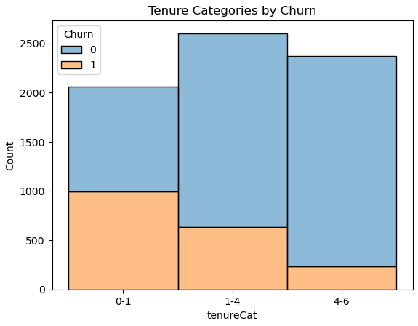
Data description
Churn Distribution by Customer Account Features
Customers with tenure of 0-1 years had a significantly higher churn rate than customers with longer tenures. Marketing strategy for such customers should be created.

Slide 12
Data Engineering
We decided to retain all the features for modeling purposes. The only feature that was removed was "customerid", which did not provide any predictive value.
Feature Removal
We added two new features. The first feature, "tenurecat", represents customer tenure as a categorical variable, with three values: 0-1 years, 1-4 years, and 4-6 years.
The second feature, "contract_renewal", is a binary variable that indicates whether the customer is on a month-to-month contract or a longer-term contract. We found that this variable had a significant impact on churn and thus decided to include it in our models.
In addition, we applied one-hot encoding. This transformed each categorical feature into a set of binary features, with one feature for each possible category.
Feature Adding
Missing Values
We discovered that 11 observations in the churn dataset had missing values in the "TotalCharge" column. Since these observations represented only a small fraction of the total dataset, we decided to remove them.

Slide 13
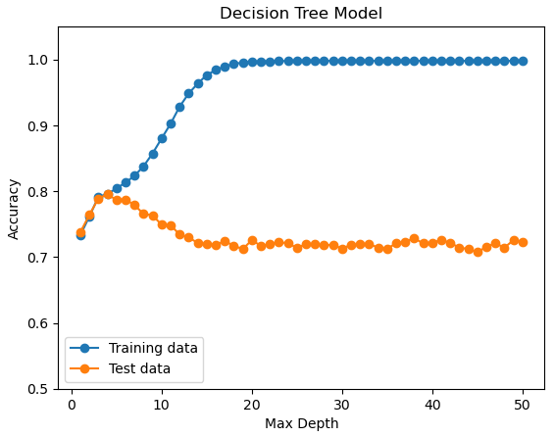
ML Algorithms
Decision Tree
We split the churn dataset into two groups: a training set (80% of the data) and a testing set (20% of the data). We then applied the Decision Tree algorithm to the training set using 50 different max depth values ranging from 1 to 50. The best max depth value was found to be 4, which achieved a prediction accuracy of 0.795 on the testing set.

Slide 14
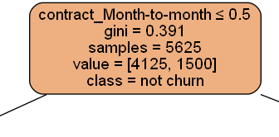
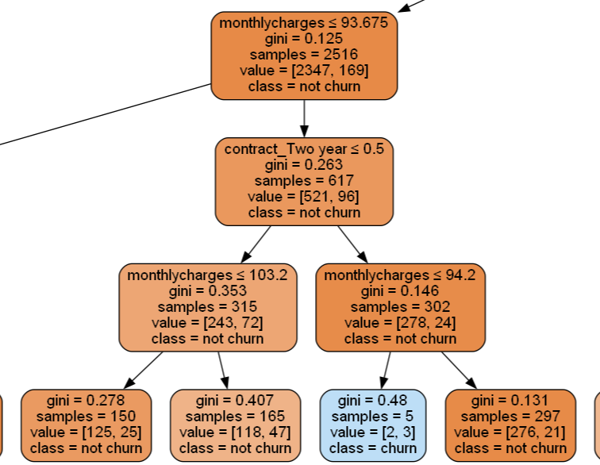
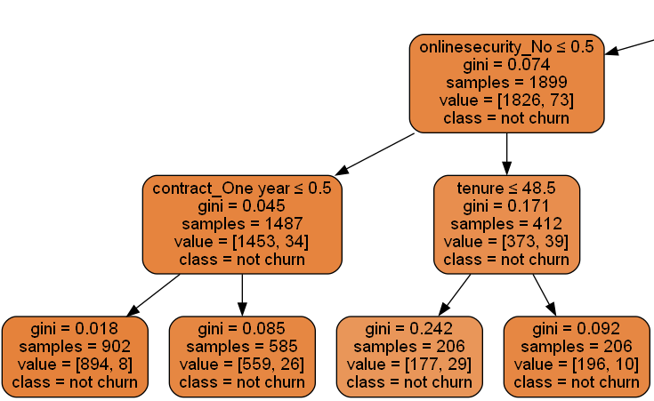
Algorithms introspection
Decision Tree
TRUE
At the top of the tree, we found that the contract_Month_to_Month feature was the most important predictor of churn. This was followed by monthlycharges and internetservice_Fiber optic. These results are consistent with our initial expectations, as these features had previously been found to have high correlation with churn.

Slide 15
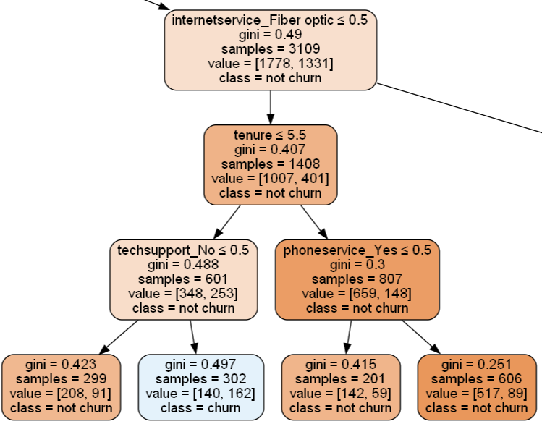
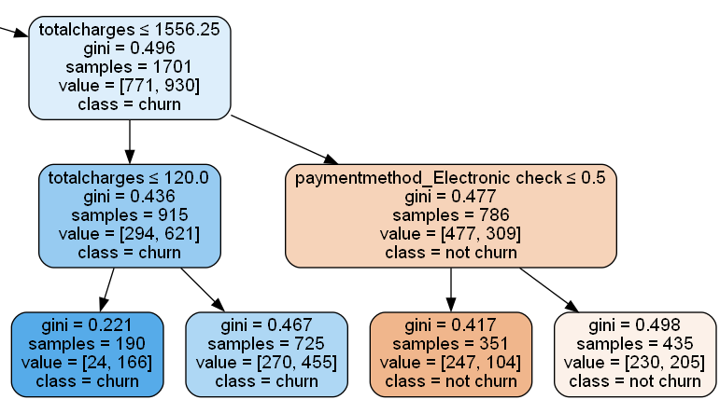
Algorithms introspection
Decision Tree
FALSE

Slide 16
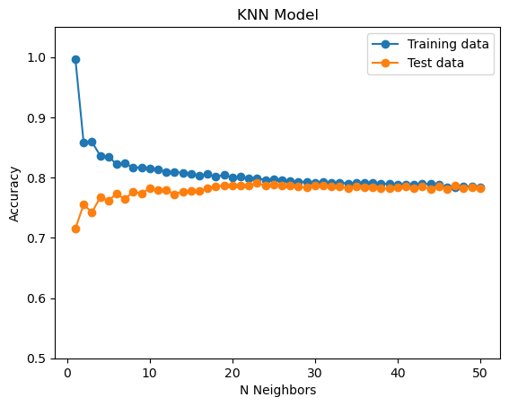
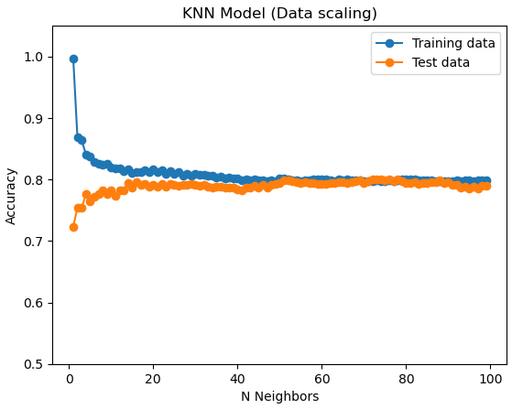
ML Algorithms
We also trained a KNN model on the churn dataset. This model achieved a prediction accuracy of 0.79, with the best value for the number of neighbors (N) set to 23. However, when we scaled the training data and re-ran the KNN model, we observed a slight improvement in prediction accuracy to 0.8. The best value of N for the scaled data was found to be 74. This suggests that scaling the data can improve the performance of the KNN model.
K Nearest Neighbors

Slide 17
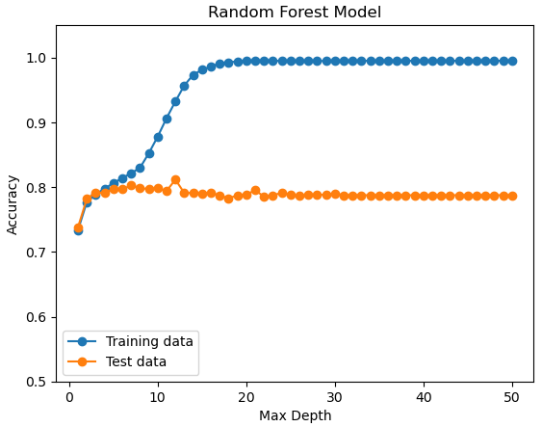
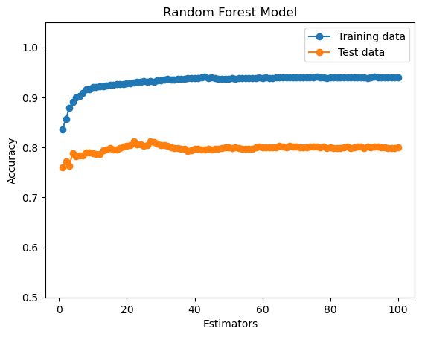
ML Algorithms
We also applied the Random Forest algorithm to the churn dataset, using 50 different max depth values ranging from 1 to 50 and 100 different estimators values ranging from 1 to 100. we found that the best combination was max depth=12 and estimators=27. This model achieved a prediction accuracy of 0.81 on the testing set. we conclude that the Random Forest algorithm is the best model for predicting churn in this dataset.
Random Forest

Slide 18
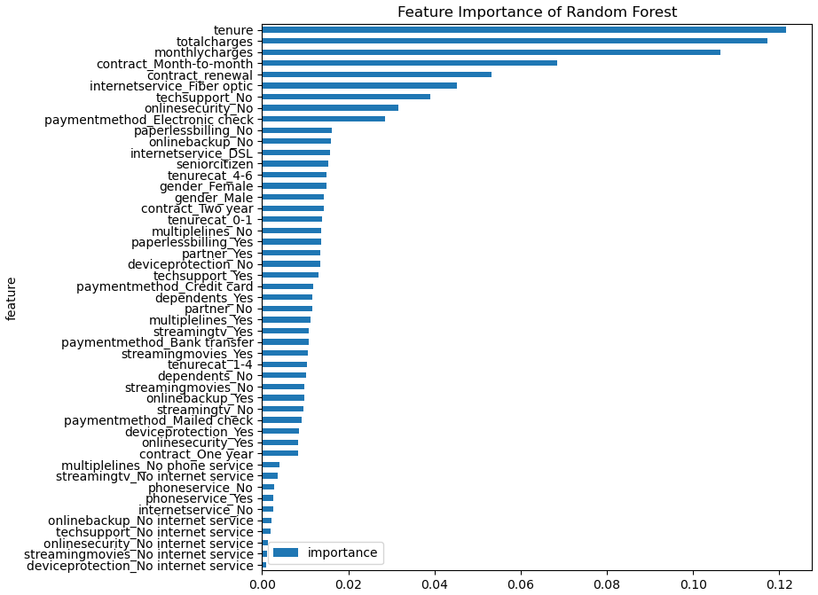
Algorithms introspection
Random Forest Model Feature Importance
The Random Forest algorithm also allowed us to investigate the relative importance of different features in predicting churn. We found that the most important features were: tenure, totalcharges, monthlycharges, month-to-month contract, and contract_renewal.

Slide 19

Main Business Insights
1
The services are probably expensive for new account holders, Marketing strategy for this group is needed.
2
Month-to-month payment type has an enormous churn rate. Marketing strategy is needed to move these customers to two-year contract and closing the month-to-month option for new customers.
3
Electronic check causes higher churn rate. It should be checked what the main reason for this is. Further, to try abandoning this way of payment.
4
Customers who have low total charges (probably are poorer) have a higher churn rate. It can indicate that the prices of the products are not affordable for many.
5
Customers with no internet service churn less. Should be decided if providing internet service justifies economically the higher churn rate.

